Slide 1
23CSE461
https://github.com/pranesh190405/MannSparsh

Slide 2



Roll No | Name | Email | Mobile No | Photo | Github URL
CB.SC.U4CSE23334 | M Pranesh | cb.sc.u4cse23334@cb.students.amrita.edu | 8856816772 |  | https://github.com/pranesh190405
CB.SC.U4CSE23563 | Juturu Naga Abhinava Sai | cb.sc.u4cse23563@cb.students.amrita.edu | 8142388150 |  | https://github.com/abhinav-juturu
CB.SC.U4CSE23544 | Bhuvanesh S | cb.sc.u4cse23544@cb.students.amrita.edu | 7358316215 |  | https://github.com/bhuvanesh-sudo

Slide 3
Collaborator Details
Collaborators Involved:
Students, Parents, School / College Counselors
Roles & Contributions:
Students: Share emotional state, academic stress, and personal challenges
Parents: Provide behavioral observations and expectation-related inputs
Counselors: Validate concerns, interpret data, and suggest professional interventions

Slide 4
Abstract
This project presents a digital mental health and psychological support system designed for students in higher education. The platform enables early identification of mental health concerns such as stress, anxiety, and burnout using self-reported data and behavioral indicators. It provides a secure environment for one-to-one online counseling sessions, scheduled interactions, and real-time support through web-based communication tools. Data visualization dashboards help counselors and institutions monitor trends while maintaining user privacy. By offering accessible, stigma-free, and technology-driven support, the system aims to improve student well-being, academic performance, and timely intervention outcomes.

Slide 5
About the Product
A web-based mental health monitoring and support platform
Specifically designed for students aged 16–22
Analyzes academic, emotional, and environmental indicators
Provides pressure visualization, emotional intelligence tracking, and guided support
Products Compared (Gap Identified)
Existing mental health applications mainly target adults or generic counseling needs
Limited focus on student-specific academic pressure and parental expectations
Key Features
Pressure gauge dashboard to visualize stress levels
Parent vs student expectation analysis
Emotion detection and visualization (smile / mood indicators)
AI-based mental health insights
Personalized recommendations and coping strategies
Reports Generated
Academic stress report
Emotional trend analysis report
Expectation gap analysis report

Slide 6
Introduction
Introduction
Students in senior secondary and higher education face intense academic pressure from exams, competitive environments, parental expectations, and career uncertainty.
These pressures often remain unnoticed until they manifest as anxiety, burnout, or depression.
Existing systems largely lack student-focused early detection mechanisms.
This product bridges the gap by integrating academic performance, emotional behavior, and environmental factors into a unified digital mental health support system.
Importance of the Product
Addresses a critical social issue
Helps in early stress identification
Supports students emotionally and psychologically
Assists parents and educators in understanding student pressure
Encourages mental well-being alongside academic success

Slide 7
What is AI role in this product?
Stress level identification based on standardized mental health questionnaires (PHQ-9, GAD-7)
Emotional state analysis from student text inputs during chatbot interactions
Pattern detection from screening history and counselling usage trends
Personalized psychological guidance through AI-assisted chatbot responses

Slide 8
What algorithm is to be used in your product and specify its purpose.
Algorithm | Purpose
Rule-based Scoring / Logistic Regression | Classify stress severity (Low / Medium / High) from screening data
Basic NLP (Keyword & Sentiment Analysis) | Detect emotional distress from student chat messages
Large Language Model (NLP) | Generate supportive, empathetic counselling responses
Statistical Trend Analysis | Identify peak stress periods and usage patterns for admin insights
Scenario of AI Usage :
AI is used for psychological first-aid, not medical diagnosis
Text-based NLP models analyze student messages to detect stress indicators
LLM-powered chatbot provides emotional support and suggests escalation to counsellors
Analytics logic helps institutions understand overall mental health trends anonymously

Slide 9
How are you building data for the problem?
Student self-assessment surveys (Academic stress, emotional well-being, anxiety levels using standardized questionnaires)
Mental health screening forms (PHQ-9, GAD-7 scores with severity classification)
Student text interactions (Chatbot conversations used for emotional and sentiment analysis)
Parent-provided expectation inputs (Optional qualitative feedback on academic and behavioral expectations)
Platform usage behavior data (Frequency of sessions, resource access patterns, counselling engagement)

Slide 10
List of startup companies working on the same problem:
Company | Problem they are working on
Headspace | Focuses on mindfulness, stress reduction, and guided mental well-being practices.
BetterHelp | Provides online counseling sessions connecting users with licensed therapists.
Wysa | Uses AI-based conversational support for emotional well-being and stress management.
YourDOST | Offers emotional support and counseling tailored for students and young professionals.
MindPeers | Provides structured therapy programs and mental health resources.

Slide 11
List of research labs working on the same products
MIT Media Lab Research on affective computing, human–AI interaction, and digital well-being systems.
Stanford Human-Centered AI (HAI) Focuses on ethical AI applications in healthcare and mental health support.
Harvard T.H. Chan School of Public Health Conducts research on digital mental health interventions and student stress analytics.
NIMHANS Research in clinical psychology, digital psychiatry, and technology-assisted mental health care.
AIIMS Studies mental health patterns, early intervention models, and public mental health systems.

Slide 12
Any media-specific input on the need of the product?
The Hindu has repeatedly reported a rise in student suicides and exam-related stress, highlighting lack of early mental health support systems in institutions.
BBC News has covered how academic pressure and uncertainty about careers are major contributors to anxiety and depression among young students globally.
The Times of India has emphasized that counselling resources in schools and colleges are insufficient, especially for large student populations.
WHO reports that mental health conditions often begin before the age of 24, stressing the importance of early detection and preventive interventions.
Indian Express has highlighted the social stigma around seeking mental health help, leading students to avoid traditional counselling centers.

Slide 13
1. Project Overview
Product Name: MannSparsh
Logo
Slogan: Here for You—Every Step, Every Struggle.
Client/Industry Targeted: Education & Healthcare.
Problem Statement: Students face invisible psychological pressure due to academics, expectations, and environment without proper monitoring or support.
Target Users: 11th, 12th & Post-school students.

Slide 14
Place details of Hackathon that was considered
Smart India Hackathon :
Problem Statement ID : 25092
Topic :Development of a Digital Mental Health and Psychological Support System for students in Higher Education .

Slide 15
User Questions Addressed by the System :
User-Specific :
What is my current stress level?
How has my mental health changed over time?
What factors are affecting my stress most?
Do I need counseling or self-help support?
Analytical :
What stress patterns are visible over time?
When do stress levels peak most often?
How effective are counseling and resources?
What common stress factors affect students?
Predictive
Is my stress level likely to increase?
Am I at risk of burnout or anxiety?
Should early intervention be recommended?

Slide 16
Functional and Non-functional requirements
Functional Requirements
User registration and role-based login (Student / Counselor / Admin)
Online mental health screening and stress level classification
One-to-one online counseling session scheduling and video meetings
AI chatbot for emotional support and guidance
Access to mental health resources and reports
Dashboard for counselors and admins to view anonymized insights
Non-Functional Requirements
Security: Encrypted authentication and protected user data
Privacy: Anonymous data handling and ethical AI usage
Performance: Real-time video and chatbot responsiveness
Scalability: Support for multiple concurrent users
Usability: Simple, accessible, and user-friendly interface
Reliability: High system availability and fault tolerance

Slide 17
What type of study the product requires?
https://www.ncbi.nlm.nih.gov/books/NBK390304/
https://www.slideshare.net/slideshow/types-of-studies-in-research/235492956

Slide 18
2. Technology Stack (MERN)
Frontend
React.js
HTML, CSS, JavaScript
Context API for state management
Backend
Node.js
Express.js
RESTful APIs
Database
MongoDB
Mongoose (schema modeling)
Real-Time Communication
WebRTC (one-to-one video counseling)
Socket.IO (signaling & real-time events)
AI / Analytics
Rule-based logic & Logistic Regression (stress classification)
NLP / LLM integration (chatbot emotional support)
Basic statistical analysis for trends
Authentication & Security
JWT (JSON Web Tokens)
bcrypt (password hashing)
Tools & Deployment
Git & GitHub (version control)
Postman (API testing)
Cloud hosting (AWS / Render / Vercel – optional)

Slide 19
Features of each listed in technology stack
Frontend
React.js – Builds fast, component-based, and responsive user interfaces
HTML, CSS, JavaScript – Structures, styles, and adds interactivity to the web application
Context API – Manages global authentication and user state efficiently
Backend
Node.js – Handles scalable, event-driven server-side operations
Express.js – Simplifies REST API development and request handling
Database
MongoDB – Stores flexible, schema-based user and screening data
Mongoose – Provides structured schema modeling and database validation
Real-Time Communication
WebRTC – Enables secure, real-time one-to-one video counseling sessions
Socket.IO – Manages signaling and real-time communication events .
AI / Analytics
Logistic Regression / Rule-Based Logic – Classifies student stress levels
NLP / LLM Integration – Analyzes text input and generates supportive responses
Statistical Analysis – Identifies stress trends and usage patterns
Authentication & Security
JWT – Ensures secure, token-based user authentication
bcrypt – Encrypts passwords to protect user credentials
Tools & Deployment
Git & GitHub – Version control and collaborative development
Postman – API testing and validation
Cloud Hosting – Enables scalable and accessible deployment

Slide 20
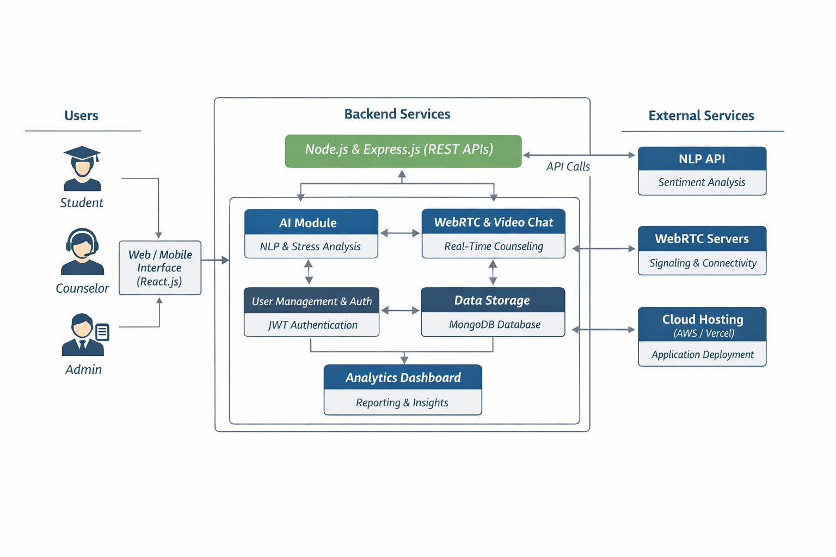
3. System Architecture

Slide 21
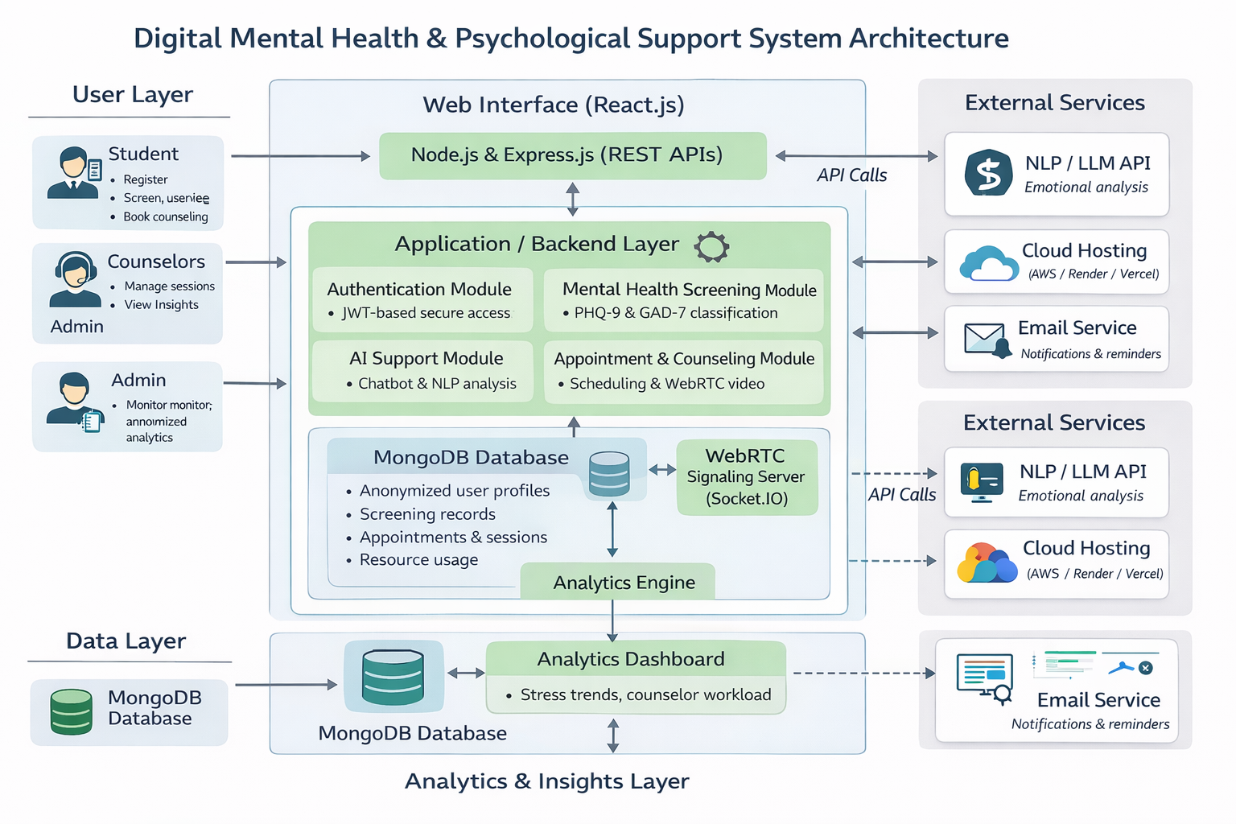
Architecture diagram

Slide 22
List of similar products in the market with its features
Product | Key Features | Primary Users | Limitations
Headspace | Meditation, mindfulness, stress relief content | Adults | Not focused on students or academic stress
Wysa | AI chatbot, emotional support, self-help tools | General users | Limited academic and institutional context
BetterHelp | Online therapy with licensed counselors | Adults | No early screening or student-specific analytics
YourDOST | Emotional support, counseling for youth | Students & professionals | Limited integration with institutions
MindPeers | Structured therapy programs, assessments | General users | Not tailored for college-level academic pressure

Slide 23
Our Product Features :
Secure role-based access for students, counselors, and admins
Anonymous mental health screening using standardized questionnaires (PHQ-9, GAD-7)
Stress severity classification (Low / Medium / High)
Appointment scheduling for one-to-one counseling sessions
Real-time online counseling via secure WebRTC video meetings
AI-powered psychological first-aid chatbot for emotional support
Personalized guidance and escalation suggestions based on screening and chat data
Mental wellness resource hub (videos, audios, PDFs)
Analytics dashboard showing anonymized stress trends and counselor workload
Novelty of the Project (Module-Aligned)
Student-centric digital mental health platform designed for institutions
Early stress detection before crisis using screening + AI support
Human-in-the-loop counseling model (AI assists, counselors decide)
Privacy-first and stigma-free design with anonymous data handling
Integrated system combining screening, counseling, AI support, and analytics

Slide 24
Work flow of the project
User Registration & Authentication : Student, counselor, and admin register and log in using secure, role-based access.
Mental Health Screening : Students complete standardized questionnaires (PHQ-9, GAD-7) anonymously.
Stress Analysis & Classification : System evaluates responses and classifies stress level (Low / Medium / High).
AI Psychological First-Aid Support : Students interact with an AI chatbot for immediate emotional guidance.
Counseling Appointment Scheduling : Students book one-to-one sessions with available counselors.
Online Counseling Session : Real-time video counseling conducted securely using WebRTC.
Resource Access : Students explore self-help resources (videos, audios, PDFs) as recommended.
Analytics & Monitoring : Admin and counselors view anonymized dashboards showing stress trends and usage insights.

Slide 25
List of Modules
Authentication & Role Management Module Handles secure login, registration, role-based access, and anonymous student identity.
Appointment Scheduling Module Enables counselors to create slots and students to book, reschedule, or cancel sessions.
Online One-to-One Counseling Module (WebRTC) Supports real-time video and audio counseling with secure meeting access.
Mental Health Screening Module Conducts standardized assessments (PHQ-9, GAD-7) and classifies stress severity.
AI Psychological First-Aid Chatbot Module Provides immediate emotional support using NLP and suggests counselor escalation.
Resource Hub Module Offers self-help mental wellness content such as videos, audios, and documents.
Admin Dashboard & Analytics Module Displays anonymized insights, stress trends, counselor workload, and system usage.

Slide 26
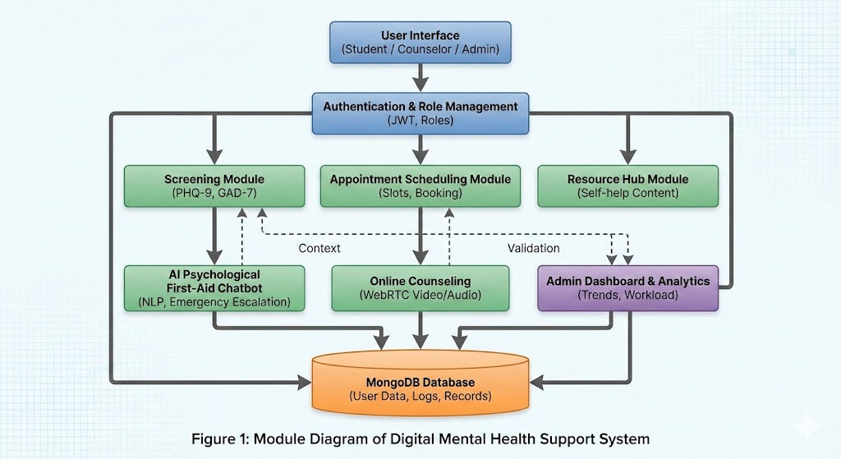
Module Diagram :

Slide 27
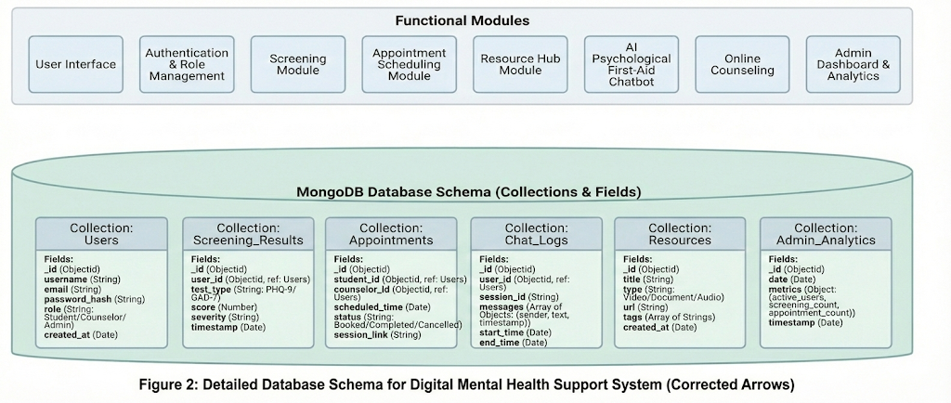
Schema Diagram:

Slide 28
Reports and Analytics
Student Mental Health Status Report
Shows aggregated stress, anxiety, and burnout levels to track overall student well-being.
Counseling Session Effectiveness Report
Evaluates improvement trends before and after counseling sessions.
Mentor Performance Report
Tracks number of sessions conducted, student feedback, and mentor availability efficiency.
Appointment Utilization Report
Identifies peak counseling hours, missed sessions, and scheduling efficiency.
High-Risk Student Identification Report
Highlights students requiring urgent attention based on assessment scores and behavioral patterns.
System Usage & Engagement Report
Analyzes login frequency, assessment participation, and session attendance.

Slide 29
Forms and User Interactions
Authentication & Role Management Module
Student Registration Form (Anonymous Option)
Counselor Registration & Verification Form
Login & Password Recovery Form
Role Assignment & Access Control Form
Appointment Scheduling Module
Counselor Availability & Slot Creation Form
Appointment Booking Form
Appointment Reschedule / Cancellation Form
Online One-to-One Counseling Module (WebRTC)
Session Join & Access Verification Form
Pre-Session Consent Form
Post-Session Feedback & Rating Form
Mental Health Screening Module
PHQ-9 Assessment Form
GAD-7 Assessment Form
Stress Severity Classification Form
AI Psychological First-Aid Chatbot Module
Chatbot Interaction & Mood Input Form
Emergency Escalation Consent Form
AI Response Feedback Form’
Resource Hub Module
Resource Search & Filter Form
Resource Feedback & Rating Form
Bookmark / Save Resource Form

Slide 30
Forms and User Interactions
Mental Health Screening Module
PHQ-9 Assessment Form
GAD-7 Assessment Form
Stress Severity Classification Form
AI Psychological First-Aid Chatbot Module
Chatbot Interaction & Mood Input Form
Emergency Escalation Consent Form
AI Response Feedback Form’
Resource Hub Module
Resource Search & Filter Form
Resource Feedback & Rating Form
Bookmark / Save Resource Form
Admin Dashboard & Analytics Module
User & Counselor Management Form
Report Filter & Generation Form
System Configuration & Access Control Form

Slide 31
Expected Output
Secure role-based access for students, counselors, and admins
Successful mental health screening results with stress classification (Low / Medium / High)
AI chatbot responses providing immediate emotional support and guidance
Scheduled and completed one-to-one counseling sessions via video conferencing
Personalized recommendations and resource suggestions for students
Anonymized analytics dashboards showing stress trends and counselor workload
Improved early stress identification and timely intervention
A scalable, privacy-preserving digital mental health platform for institutions

Slide 32
If product needs to change to Mobile stack what will be the changes required?
Frontend Changes
Replace React.js (Web) with React Native / Flutter
Redesign UI for mobile screens, touch gestures, and navigation
Use mobile permissions (camera, microphone, notifications)
Backend Changes
No major change in backend (Node.js + Express remains the same)
APIs continue to serve mobile clients instead of web
Add rate limiting & mobile session handling (optional)
Database Changes
No change in MongoDB schema
Optimize queries for mobile network efficiency
Real-Time Counseling Changes
Replace browser-based WebRTC with mobile WebRTC SDKs
Handle background app behavior during video calls
Improve network fallback handling (Wi-Fi ↔ mobile data)
AI & Chatbot Changes
AI logic remains unchanged
Optimize chatbot responses for mobile UI
Optional: add voice input/output using mobile APIs
Authentication & Security Changes
JWT remains the same
Store tokens securely using Secure Storage / Keychain
Add biometric login (fingerprint / face ID) – optional
Notifications
Add push notifications (Firebase Cloud Messaging / APNs)
Appointment reminders & alerts via mobile notifications
Deployment Changes
Web hosting → Play Store / App Store deployment
App signing, versioning, and store compliance required

Slide 33
If product can become a DevOps solution how it can be done?
1. CI/CD Pipeline Integration
Use GitHub Actions / GitLab CI to automate build, test, and deployment
Every code change triggers automatic testing and deployment
2. Containerization
Package backend, frontend, and services using Docker
Ensures consistent environments across development, testing, and production
3. Cloud Infrastructure Automation
Deploy services on AWS / Azure / GCP
Use Infrastructure as Code (IaC) tools like Terraform for repeatable setup
4. Environment Management
Separate Development, Testing, and Production environments
Use environment variables for secure configuration management
5. Monitoring & Logging
Integrate Prometheus / Grafana for performance monitoring
Centralized logging using ELK stack (Elasticsearch, Logstash, Kibana)
6. Scalability & Reliability
Use load balancers and auto-scaling for handling peak student usage
Ensure high availability of counseling and chatbot services
7. Security & Compliance (DevSecOps)
Automated security checks in CI pipeline
Regular vulnerability scanning and access control audits

Slide 34
What is the proposed solution for integrating this product to cloud?
1. Cloud Platform Selection
Deploy the system on AWS / Azure / GCP based on availability and scalability needs
Use cloud services to ensure high availability and reliability
2. Application Deployment
Host Frontend (React) on cloud services like AWS S3 + CloudFront / Vercel
Deploy Backend (Node.js + Express) on EC2 / App Service / Cloud Run
Use Docker containers for consistent deployment
3. Database Hosting
Use MongoDB Atlas (Cloud-hosted)
Enables automatic backup, scaling, and high availability
4. Real-Time Communication Support
Deploy WebRTC signaling server on cloud VM or container service
Use cloud networking for low-latency video counseling
5. AI & External Services Integration
Integrate NLP / LLM APIs securely via cloud environment variables
Centralized API management through cloud backend
6. Security & Access Control
Implement JWT-based authentication
Use HTTPS, SSL certificates, and cloud IAM policies
Secure secrets using cloud secret managers
7. Scalability & Load Management
Enable auto-scaling for backend services
Use load balancers to distribute traffic efficiently
8. Monitoring & Maintenance
Use cloud monitoring tools for logs, uptime, and performance
Automated alerts for failures and high usage

Slide 35
List of research papers published related to this product
Digital Mental Health Interventions for Depression and Anxiety Reviews effectiveness of digital platforms for early mental health intervention.
AI-Based Chatbots for Mental Health Support Discusses NLP-driven chatbots for psychological first aid and emotional support.
Mental Health Among College Students Analyzes academic stress, anxiety, and depression patterns in students.
Ethical Challenges in AI-Based Mental Health Systems Highlights privacy, anonymity, and ethical AI usage in mental health platforms.
Web-Based Counseling Systems in Higher Education Evaluates effectiveness of online one-to-one counseling models.
Early Detection of Mental Stress Using Digital Screening Tools Supports questionnaire-based early stress detection approaches (PHQ-9, GAD-7).

Slide 36
Cost of the product
Development Cost
Frontend & Backend Development: ₹0 (Student-developed / Academic project)
AI & Analytics Implementation: ₹0 (Open-source libraries / APIs)
Infrastructure Cost (Cloud – Monthly Estimate)
Cloud Hosting (Backend + Frontend): ₹1,500 – ₹3,000
MongoDB Atlas (Basic Tier): ₹1,000 – ₹2,000
WebRTC Signaling Server: ₹1,000 – ₹2,000
AI / NLP API Usage (Limited): ₹1,000 – ₹3,000
Operational Cost
Maintenance & Monitoring: ₹0 – ₹1,000
Email / Notification Services: ₹500 – ₹1,000
Total Estimated Monthly Cost
₹5,000 – ₹10,000 per institution

Slide 37
Our product is unique because…
It is designed exclusively for students in educational institutions, not general users
Focuses on early stress detection using standardized screening tools
Combines AI psychological first-aid with human counselor intervention
Provides real-time one-to-one online counseling within the same platform
Ensures privacy-first and anonymous mental health support
Integrates screening, AI support, counseling, resources, and analytics in one system
Enables institutions to gain data-driven insights without exposing individual identities

